Slide 1
Task 1 – Dataset (Penguins)
The data set consists of 50 samples from each of three species of Penguins (Adelie , Chinstrap, and Gentoo).
Five features were measured from each sample: CulmenLength, CulmenDepth, FlipperLength, OriginLocation, BodyMass.

Slide 2
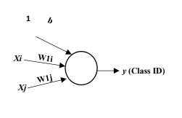
Task 1 - GUI
User Input:
Select two features
Select two classes (C1 & C2 or C1 & C3 or C2 & C3)
Enter learning rate (eta)
Enter number of epochs (m)
Enter MSE threshold (mse_threshold)
Add bias or not (Checkbox)
Choose the used algorithm perceptron or Adaline (radio button)
Initialization:
Number of features = 2.
Number of classes = 2.
Weights + Bias = small random numbers
Classification:
Sample (single sample to be classified).

Slide 3
Task 1 - Description
Implement the Perceptron learning algorithm
Single layer neural networks which can be able to classify a stream of input data to one of a set of predefined classes.
Use the penguins data in both your training and testing processes. (Each class has 50 samples: train NN with 30 non-repeated samples randomly selected, and test it with the remaining 20 samples)

Slide 4
Task 1 - Description
Implement the Adaline learning algorithm using MSE
Single layer neural networks which can be able to classify a stream of input data to one of a set of predefined classes.
Use the penguins data in both your training and testing processes. (Each class has 50 samples: train NN with 30 non-repeated samples randomly selected, and test it with the remaining 20 samples)

Slide 5
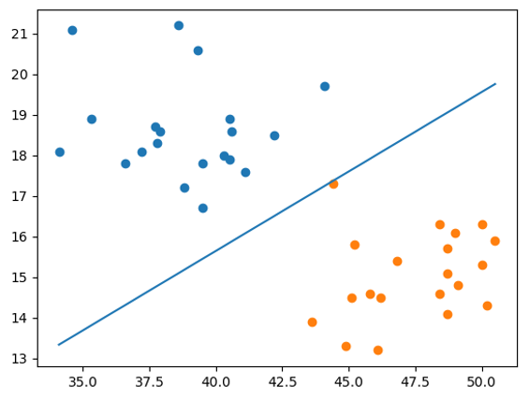
Task 1 - Description
After training
Draw a line that can discriminate between the two learned classes. You should also scatter the points of both classes to visualize the behavior of the line.
Test the classifier with the remaining 20 samples of each selected classes and find confusion matrix and compute overall accuracy.

Slide 6
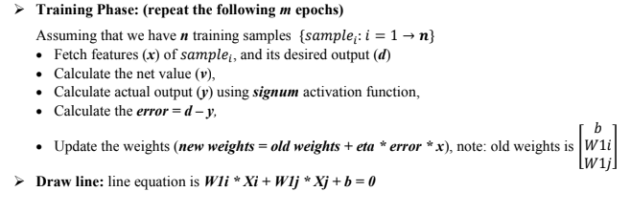
Task 1 – Workflow (Perceptron)

Slide 7
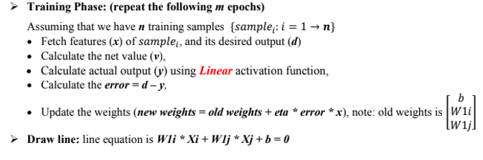
Task 1 – Workflow (Adaline)

Slide 8
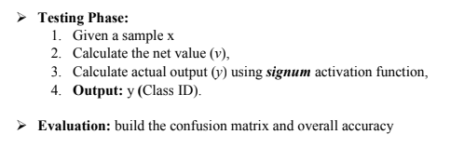
Task 1 - Workflow

Slide 9
Task 1 - Notes
You will be asked to deliver a .rar folder containing all your code files (.py), dataset and the visualization and analysis report.
In the report you should have screenshots/plots of the visualizations and a written analysis of what you understood from each of these visualizations and how the features discriminate or not between classes. You should have a plot and analysis for at least 5 combinations for each algorithm. These combinations should show good and bad performance examples and represent a variety of features and classes combinations.
At the end of the report, you should mention which features achieved the highest accuracy after running your algorithm.
You should not drop any row from the dataset.
For the ‘OriginLocation’ column, you should preprocess it before using it as a feature
Using scikit-learn metrics library or any similar built-in function for the confusion matrix is not allowed.

Slide 10
Task 1 - Notes
Lab 3 including Task 1 description will be available Friday 17/10/2025. Task Deadline: Friday 31/10/2025 11:59 PM.
Please try to write well designed code.
Separate the logic (generation, loading, and classification) from the UI.
Writing well-documented, readable, maintainable, and extensible code is an extremely important skill you must master before graduating. So, don’t be lazy!
Cheating detection will be applied and will not be tolerated.

Slide 11
Thank you

